Slide 1
CHAPTER-6
POLYMERS
By:- Fanta W. (MSc)

Slide 2
Polymers
Polymers
are macro (large) molecules made from smaller repeating units called monomers.
Have hybrid form.
Monomers :-are
the building blocks of polymers,
more reactive than polymers,
multiple bond ( )consistent molecules or bifunction molecules.
Polymers based on type of monomer used to polymerization classified into:-
    Homopolyerms,
    Coploymers,
    Terpolymers,...

Slide 3
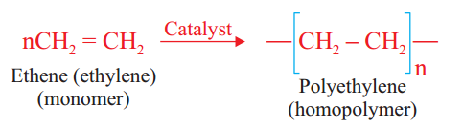
Cont...
polymers classification:
Terapolymers: are
made from three type of monomer.
Homopolymers: are
made from only one type of monomer.
polymerization of the same kind of monomer favourable in presence of catalyst.
Eg n[CH₂=CH₂ ]
n[CH₂=CH-CH=CH₂ ]
n[CH₂=CH-CH₃]
Copolymers: are
made from two type of monomer.
n[CH₂=CH₂ ] + m[CH₂=CH-CH=CH₂ ]
Note that:
1.dicarboxylic acid + dialcohol → Polyester + H₂O
2. Dicarboxylic acid + diamine → Polyamide + H₂O
3. Different alkene monomer combination
catalyst
polymers
catalyst
catalyst
Tetrapolymers: are
made from four type of monomer.
catalyst

Slide 4
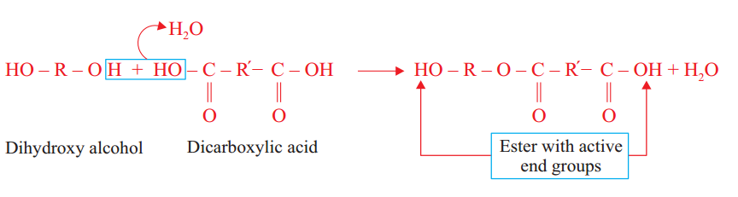
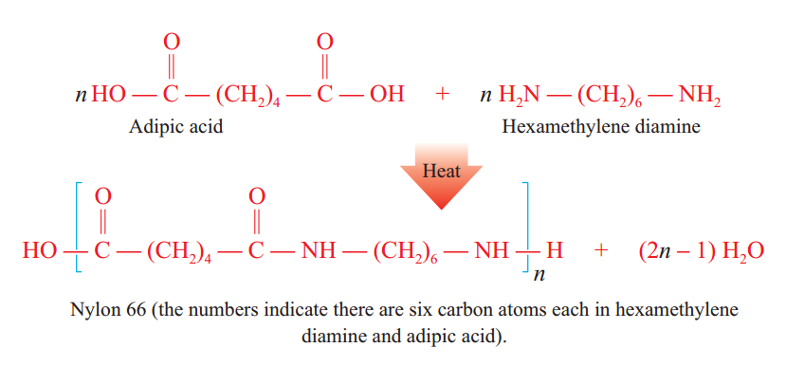
Cont...
Copolymer example:

Slide 5
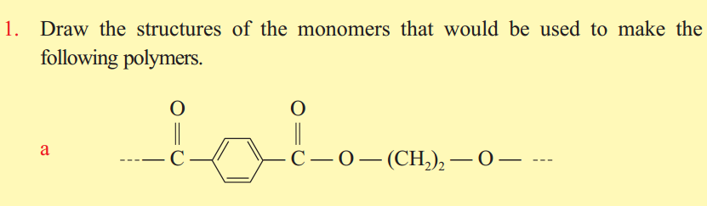
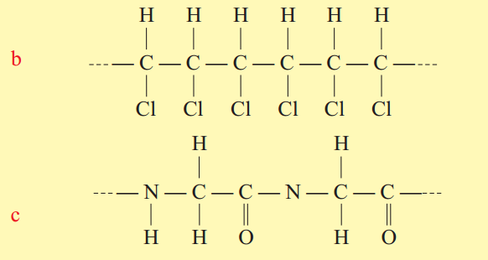
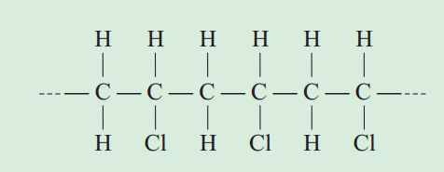
Exercise

Slide 6
Cont...
Copolymers based on the arrangement of monomer classified into two:
Copolymers
Random Arrangement: arrangement of monomer in random ( disorder) order. Eg. –A-B-B-A-B-A-A-B-A-B-
Regular Arrangement: arrangement in sequence ( repeating order) of monomer. Eg. –A-B-A-B-A-B-A-
Polymers
Synthetic polymers:
are man-made polymers.
are organic compound polymers.
are not biodegradable & very strong.
Example: polyethylene, Teflon, PVC, nylons, Dacron, rayon, synthetic rubber.
Natural polymers:
are found in nature
are biodegradable molecules.
Example: proteins, carbohydrate( starch, cellulose & glycogen), nuclei acids, natural rubber, cotton, wool, insulin, DNA..

Slide 7
Polymerization
is the process of combination of small molecules repeatedly many times to form a large molecule(polymer).
Polymerization
Addition Polymerization( Chain-growth): is a process in which the monomer units join with one another to form a polymer without elimination of small molecules.
The monomers are: mostly unsatured, homopolymers. can be similar or d/t,
The simplest formula of the monomer is the same as the polymer. M_{p}= n X M_{m}
Where Mp =molar mass of polymer, Mm = molar mass monomer, n = monomer unit.
Example: PVC, PMMA, Teflon, polystyrene, perspex,...
Condensation Polymerization( Step-growth):is a process in which the monomer units join with one another to form a polymer with elimination (expulsion)of small molecules like H₂O.
The monomers are mostly have bifunctional group, different type, mostly copolymers.
The simplest formula of the monomer & polymer not the same.
Example: nylon, dacron(polyester), kelvar, nomex, proteins, starch, cellulose, bakelite,....

Slide 8
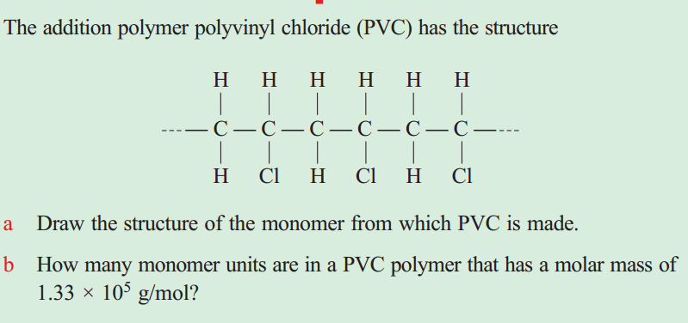
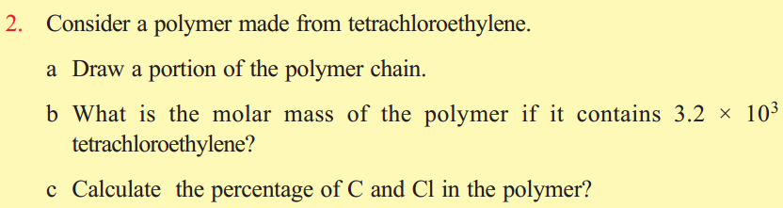
Cont...
Exercise:
I. Synthetic Polymers: A) Addition polymerization(Homopolymerization)
The first semi-synthetic polymer produced was Bakelite in 1909
In 1911, Bakelite was followed by rayon, the first synthetic fiber.

Slide 9
Cont...
 | Polymers | monomers | properties | uses
1 | polyethylene | Ethylene(CH₂=CH₂) | Has no taste, nontoxic, light weight | Used for making bottles, trash bags electrical insulation,...
2 | Polypropylene | propylene | Is stronger than polyethylene | Used for making food container, ropes, bottles,...
3 | Polyvinylchloride (PVC) | Vinylchloride( CH₂=CHCl) | Is stronger than polyethylene | Used for making pipes, leather, shoes, wall papers,...
4 | Polymethylmethacrylate(perspex) | Methylmethacrylate( CH₂=C(CH₃)CO₂CH₃ | Is sold under the trade name lucite or plexi glass & light weight glass | Used for making air plane windows, lab. Good, street lights...
5 | Polytetrafluoroethylene( Teflon) | Tetrafuoroethylene( CF₂=CF₂) | Has good resistance of chemical attack, resist any temp, b/n -73 to 260 | Used for coating cooking utensils, electrical insulation...
6 | Polystyrene | Styrene( CH₂=CHph) | Is solid at room temp. | Used for making CD, DVD, toys, architectural models...

Slide 10
Cont...
Note that:
Plastics are synthetic polymers & classified into two:
polyethylene
Low density polyethylene(LDP): more transparent, flexible, waxy, branched polymer
High density polyethylene(HDP):more opaque, rigid, non-waxy, linear polymer
Thermoplastics | Thermosetting plastics
On heating, they do not soften, can be reshaped, reused, recycled. They are generally linear or branched in structure. They have low m.pt & b.pt They are generally weak, soft & less brittle Polymer held together by Intermolecular force Example: polyethylene, PVC, Teflon, PMMA, Nylons, Dacron, polypropylene | On heating, they often soften, cannot reshaped, reused & recycled. They have three dimensional cross-linked structure. They have high m.pt & B.pt. They are hard, strong & brittle. Polymer held together by chemical bonded with other. They are primarily used in automobiles & construction. Example: Bakelite, formica.. .

Slide 11
B. Condensation polymerization( Copolymerization)
 | Polymers | monomers | properties | uses
1 | Nylons: Nylon 6,6 | Adipic acid & hexamethylene diamine( diacid s & diamines) | Nylons 6,6 are polyamides, salts. | Used for making parachutes, ropes, clothes, stockings, hair combs, reinforce automobiles tires
 | Nylon 6 | Caprolactam( cyclic amide 6C consistent | Polyamide, synthetic fibers
2 | Polyester( Dacron ) | Terephthalic acid ( 1,4-benzene dicarboxylic acid & ethylene glycol (1,2-etanediol). | Is strong & impact resistant colourless, high transparent, | Is used to make synthetic fibers, bottles, packing materials...
3 | kelvar | Terephthalic acid & 1,4-benzene diamine | Kelvar is polyamide | used in bullet proof vests.
4 | Nomex | 1,3-benzene dicarboxylic acid & 1,3-benzene diamine | Npmex is polyamide | Used in fire-resistant clothing
5 | Bakelite | Phenol & formaldehyde | Rxn of monomer take place in presence of an acid or a base as catalyst | Used for making rotary-dial telephones, chess, checkers...
6 | Polycarbonates (Phenol & carbonic acid): Eg. Bisphenol & phesgene, named as lexan

Slide 12
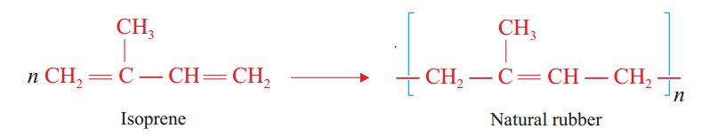
Impacts of synthetic polymers on Environment
Synthetic polymers pollute the env`t during their uses, preparations & disposals.
Major problems caused by plastics are env`tal pollution & health risks.
II .Natural Polymers
Natural Rubber: is obtained from rubber tree & its monomer is isoprene( 2-methyl-1,3-butadiene).
Natural rubber: is an example of elastomeric type.
  Is soft & sticky solid.
  Is soft in hot & hard in cold water.
  Is soluble in organic solvents such as CS₂, petrol, ether...

Slide 13
Cont...
Vulcanization is hardening of rubber by heating rubber with sulphur.
Sulphur is used to joins or cross-link the polymer b/n linear chain.
Vulcanized rubber has the following properties:-
  It is hard & non-sticky.
  It has higher elasticity, which occurs over high range of temperature.
  It has high tensile strength.
  It is not oxidized readily.
  2. Synthetic Rubber:
  Is produced either by the polymerization of conjugated dienes in the presence of a catalyst or by copolymerization of conjugated dienes with other olefin compounds.

Slide 14
Cont...
 | Synthetic Rubber | Monomers | properties | uses
1 | Neoprene | 2-chloro-1,3-butadiene (Chloroprene) | Formed by addition polymerization. Is a linear thermoplastic polymer & resist chemicals | Used for making hoses for chemicals petrol & oils
2 | Styrene butadiene rubber(SBR) | Styrene( CH₂=CHph) & butadiene( CH₂=CH-CH=CH₂) | Is supersion to natural rubber with regard to chemical strength. Is a copolymer at styrene with butadiene | Is used primarily in manufacturing tires & chemical goods
3 | Butyl Rubber | Isoprene( 2-methyl-1,2-butaiene) & 2-methylpropene | Butyl rubber holds air better than natural rubber | Used for making inner tubes

Slide 15
2. Carbohydrates
Carbohydrates:
  are contain carbon, hydrogen & oxygen.
  have molecular formulas that corresponds to C_{n}H_{2n}O_{n} or C_{n}(H₂O)_{n}.
  Green plants produce carbohydrates by photosynthesis.
  All carbohydrates are not polymers
  are defined as polyhydroxy aldehydes, polyhydroxy ketones or
  compounds that yield such substance upon hydrolysis.
  Carbohydrates are classified on the basis of their acid-catalyzed hydrolysis products as
      monosaccharide,
      disaccharides and
      polysaccharides.

Slide 16
Cont...
A. Monosaccharides ( simple Sugar)
  cannot hydrolysed into small molecules.
  Consist C₃ to C₇ in structure (triose, tetroses, pentoses, hexoses).
  Oxidized by Benedict or Fehling solution.
Note that: fructose, glucose, galuctose & ribose are soluble in water, white, crystalline solids, reducing sugars.
Glucose & galuctose- can form six member ring called pyranose &
fructose & ribose – can form five member ring called furanose
Monosaccharides
Ketose
Aldose
Fructose (Ketohexose): sweetest-testing of all sugar
Glucose (Aldohexose): blood sugars, primary energy.
Galuctose (aldohexose) : formed from glucose
Ribose( Aldopentose): component of RNA & ATP

Slide 17
B. Disaccharides
Disaccharides are
  dimers( two monosaccharides) & sugars.
  joined by α-1,4-or β-1,4-glycosidic linkage.
  Note that: maltose, cellubiose, lactose & sucrose have the same molecular formula( C₁₂H₂₂O₁₁)
Disaccharides
Maltose: contain 2 glucose linked by α-1,4-glycosidic linkage
Cellubiose: contains 2 glucose linked byα-1,4-or β-1,4-glycosidic linkage .
Lactose β-galuctose linked by β-1,4-glycosidic linkage
Sucrose: common sugar.
α-glucose & β-fructose linked by α, β-1,2-glycosidic linkage .

Slide 18
C. Polysaccharides
Polysaccharides are polymers.
All types of polysaccharides consist glucose units & bonded together by glycoside bonds.
Polysaccharides
Cellulose:
is a linear glucose polymer linked by β-1,4-glycosidic linkage.
is not source of nutrition.
Starch:
used for energy storage in plants.
All of the glycoside linkages in starch are α-type linkage
Starch: amylopectim & amylose
Glycogen:
is animal starch. Is glucose storage in human.
is branched structure linked by α-1,4-or β-1,6-glycoside

Slide 19
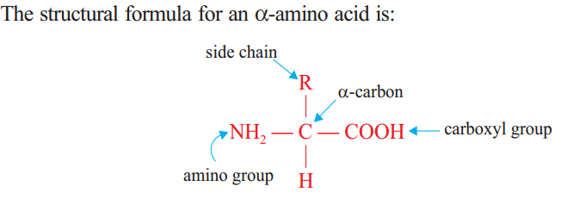
3. Proteins
The name protein comes from the Greek word “proteios” which means “primary”.
All proteins contain carbon, hydrogen, oxygen and nitrogen. Many proteins also contain sulphur.
Proteins are made by the polymerization of the twenty naturally occurring amino acids.
All amino acid of proteins contain α-amino acids.
Based on the side chain polarity, amino acids can be grouped into four categories:

Slide 20
Cont...
Nonpolar amino acids; | Polar neutral amino acids; | Polar acidic amino acids | Polar basic amino acids
contain one amino group, one carboxyl group, and a non-polar side chain. R-side alkyl-group (non-polar= water-fearing or hydrophobic) | contain one amino group, one carboxyl group, and a side chain that is polar but neutral. R-side hydroxyl-group, SH-group, -CONH₂ | contain one amino group and two carboxyl groups. The second carboxyl group is part of the side chain. R-side = -COOH or carboxyl group | contain two amino groups and one carboxyl group. The second amino group is part of the side chain. R-side = -NH2 or amino group

Slide 21
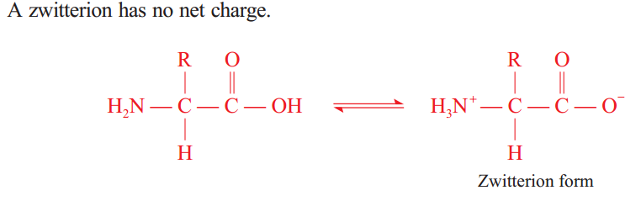
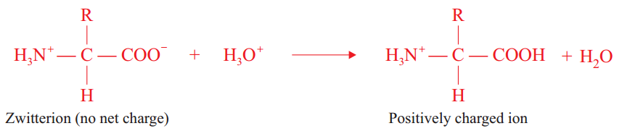
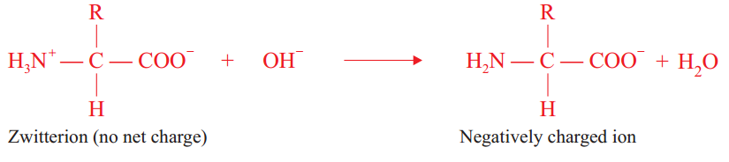
Cont...
Physical Properties of Amino Acids:
i) They have high melting points.
ii) They are colourless crystalline substances.
iii) They are soluble in water but insoluble in non-polar solvents.
iv)They resemble ionic compounds(The dipolar ion or internal salt of an amino acid is called zwitterion).
Conj. Acid, pH<7, acidic sol.

Slide 22
Peptide Bond Formation
A peptide (amide) is a bond formed between the carboxyl group of one amino acid and the amino group of another amino acid.
Amino acid + amino acid →dipeptide, the process of peptide formation favoured by condensation polymerization.
A polypeptide is a sequence of amino acids, containing up to 50 amino acid units, in which the amino acids are joined together through amide (peptide) bonds.
Proteins are polypeptides that contain more than 50 amino acid units.
1. Why amino acids form zwitterions?
Since they contain both acid and base functional groups in the same molecule, the acid donates proton and the base accepts the proton.

Slide 23
Cont...
2. How many different tripeptides can be obtained by various combinations of three amino acid residues?
The number of tripeptides is 3! = 3 x 2 x 1 = 6
3. How do amino acids join together to form proteins?
The amine functional group of one amino acid molecule reacts with the acid functional group of the other amino acid to from amide or peptide bond. This continues until proteins are formed.
4. What type of polymerization is it?
Condensation polymerization.
5. What are the differences between different proteins?
All proteins are made from the 20 amino acids. However, all proteins do not have the same sequence of amino acids. As a result, different proteins have different functions.

Slide 24
THANK YOU!
THANK YOU!

